Slide 1
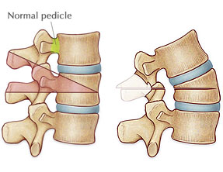
Osteotomies for Deformity Correction

Slide 2
CONCEPT
BALANCED SPINE

Slide 3
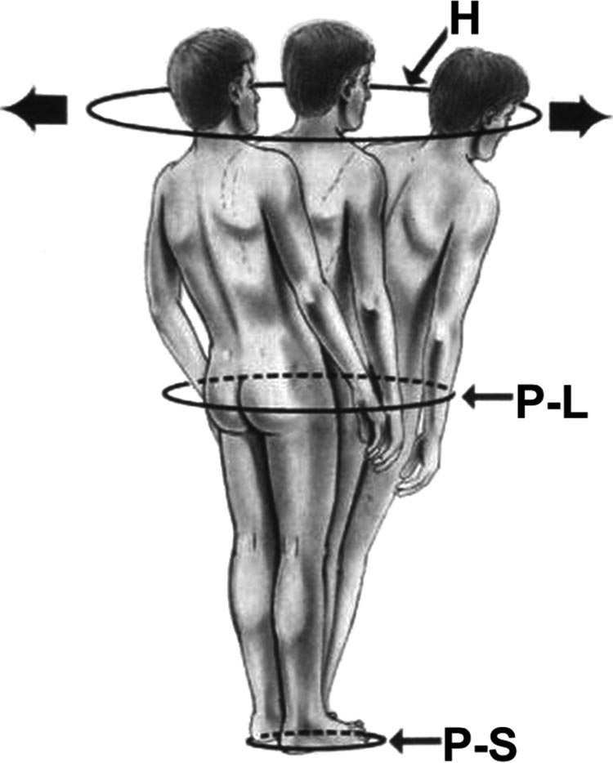
Cone of Balance/
Zone of Economy
Dubousset J. Three-dimensional analysis of the scoliotic deformity. In: Weinstein
SL, ed. Pediatric Spine: Principles and Practice. New York, NY: Raven
Press; 1994.

Slide 4
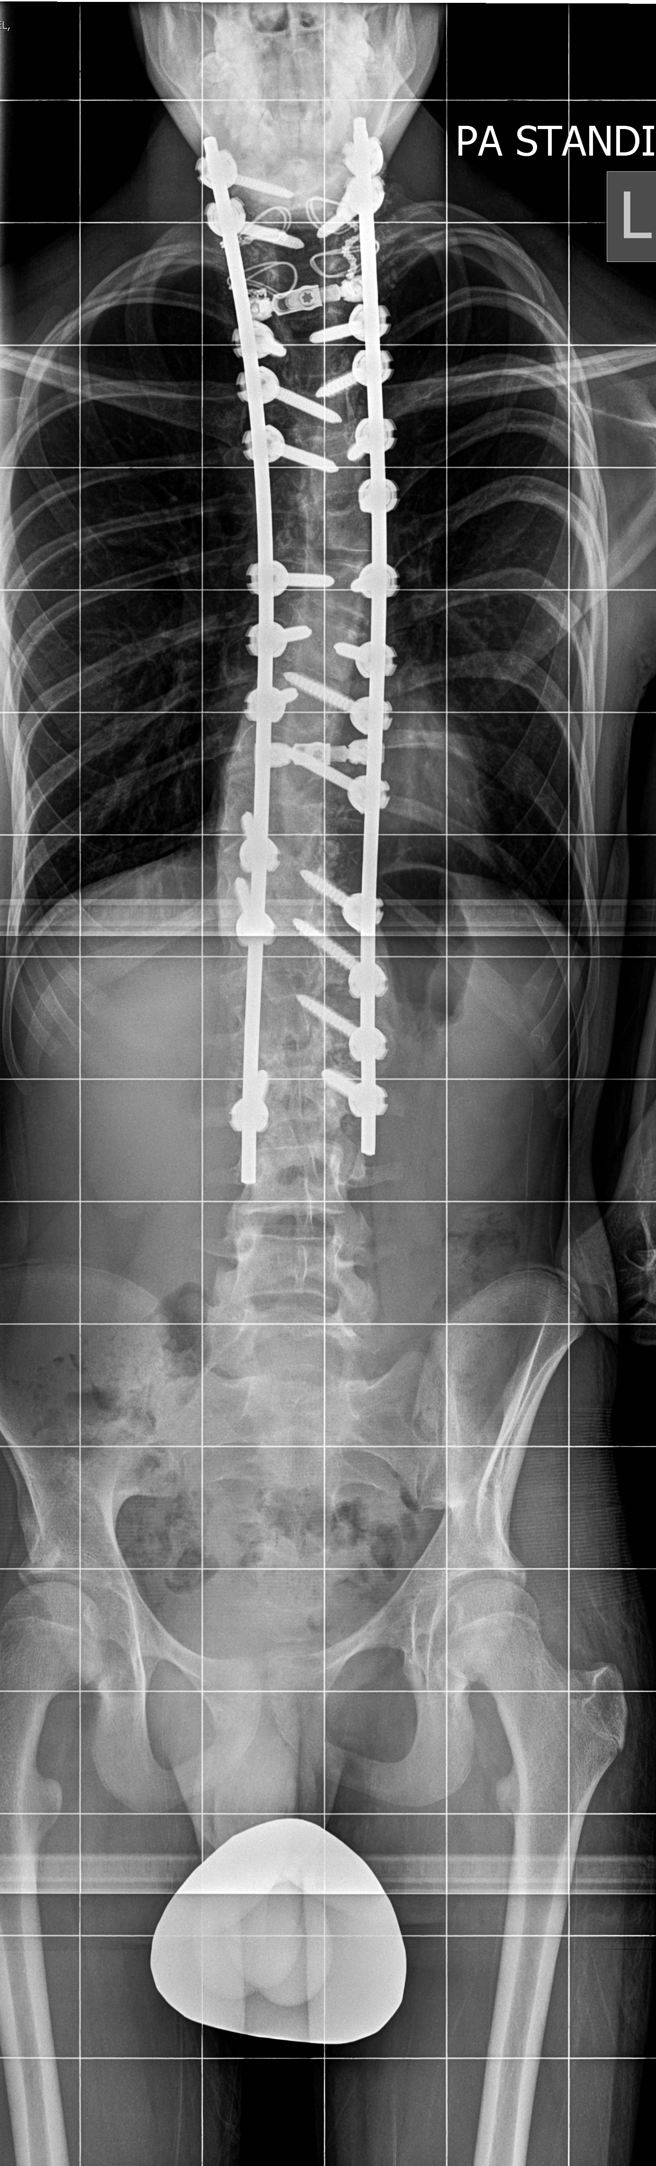
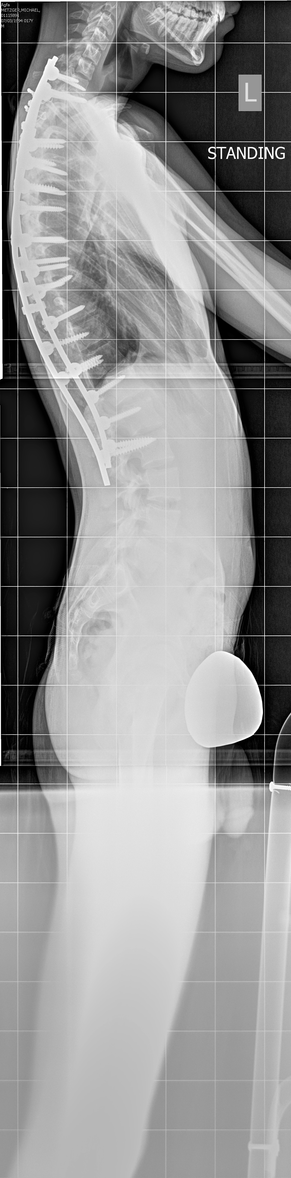
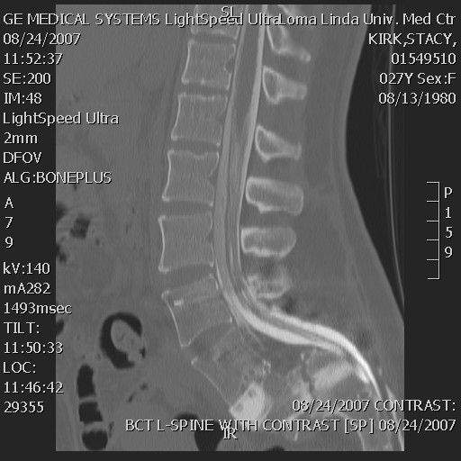
Radiographs
36 “ standing xray
CT myelogram
CT + MRI
DEXA

Slide 5
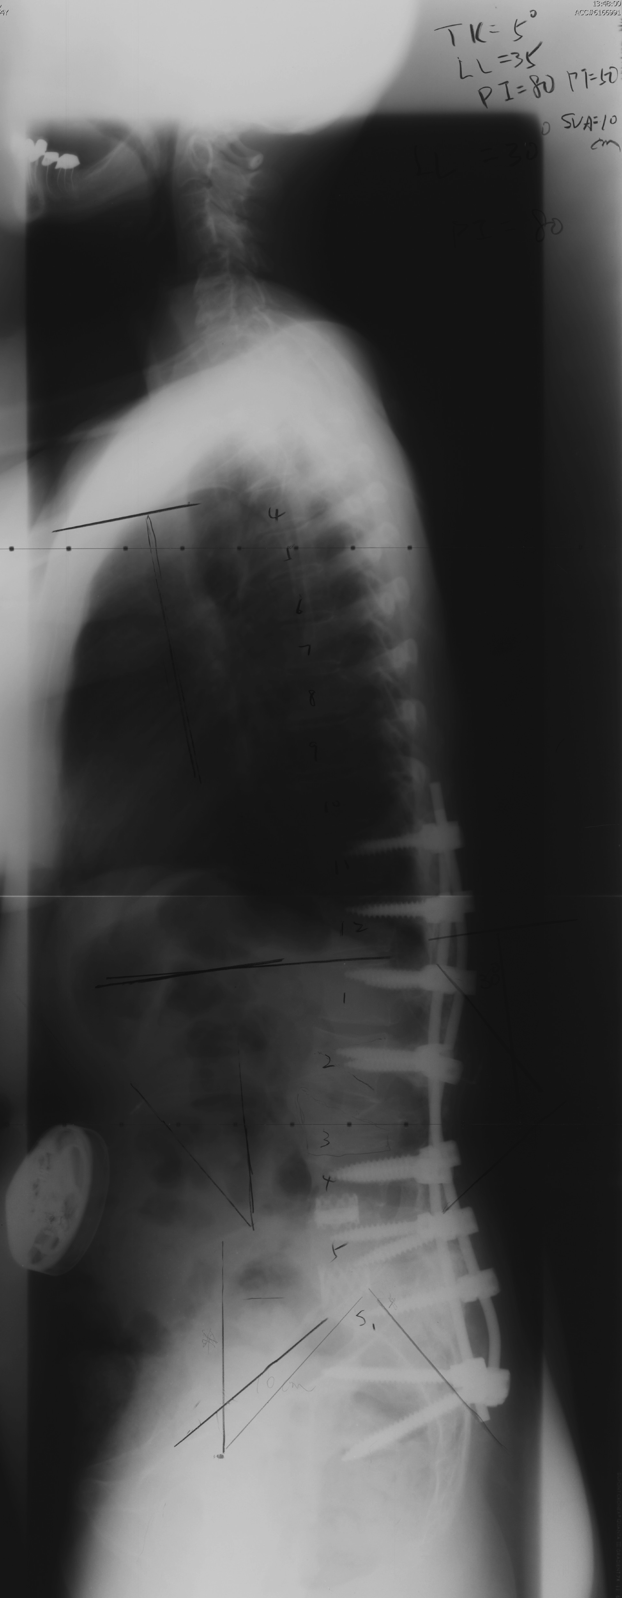
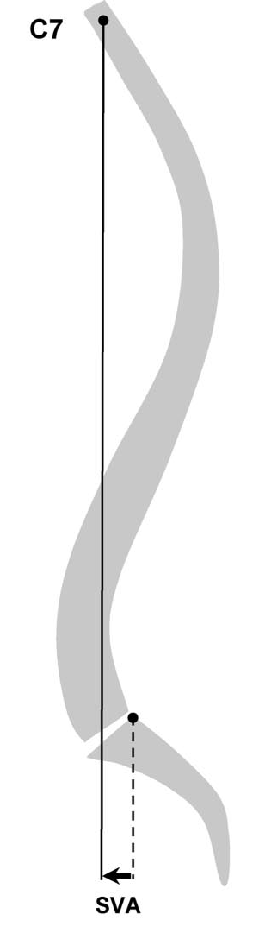
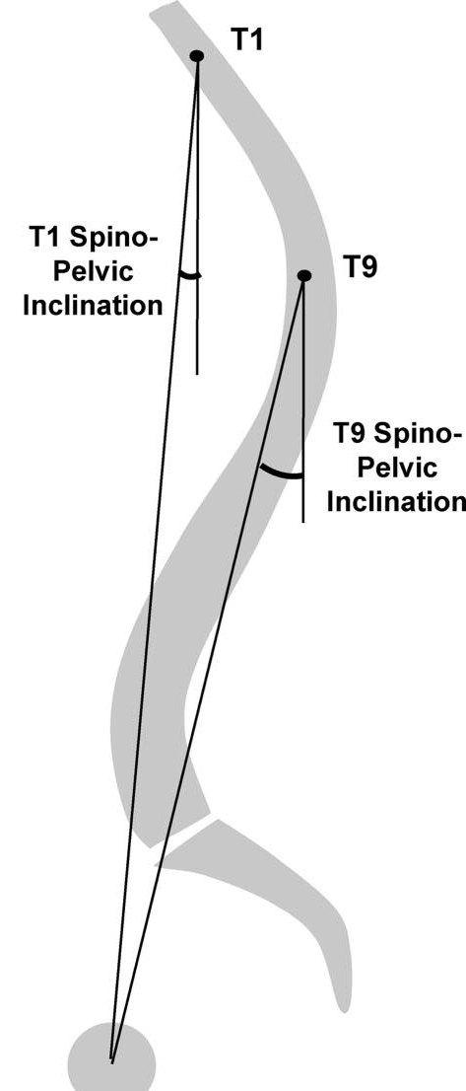
Sagittal Balance

Slide 6
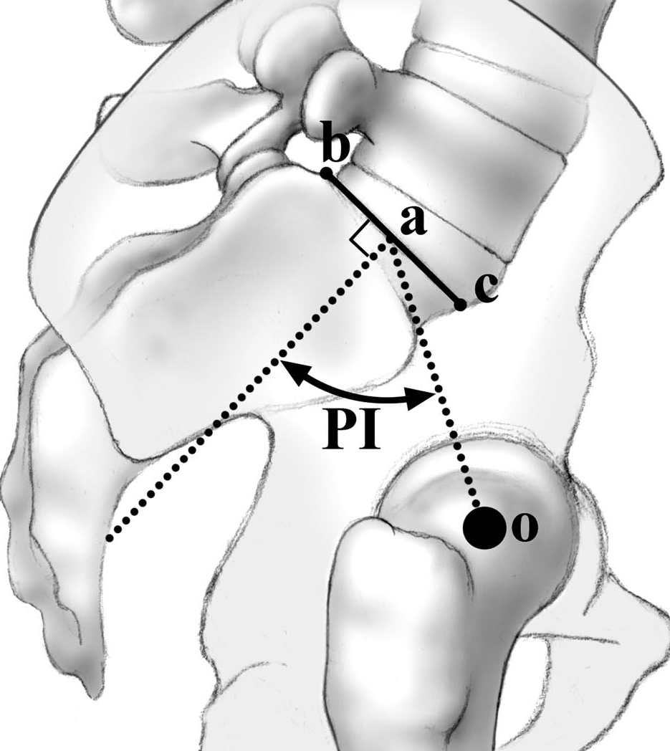
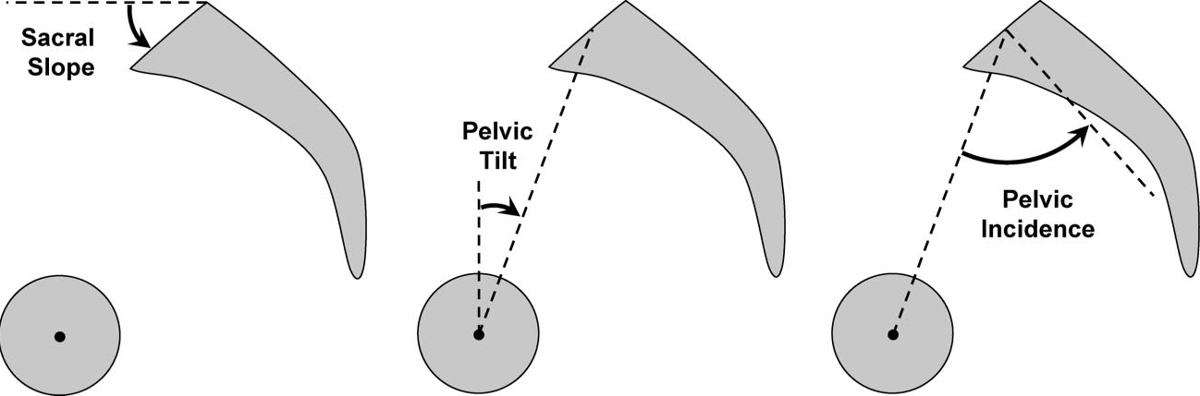
Pelvic Perimeters

Slide 7
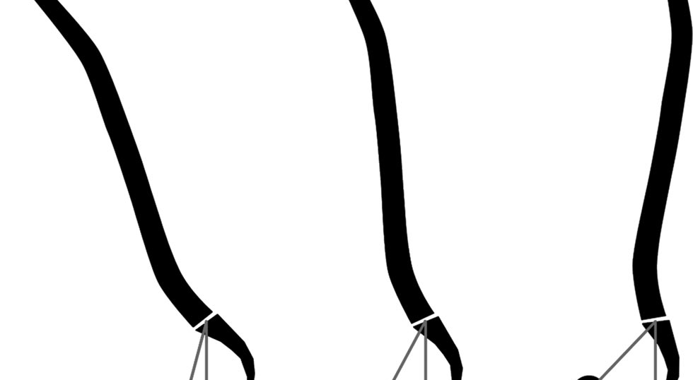
Pelvic Retroversion

Slide 8
Which One is most important?
Based on HRQL (health related quality of Life) tools.
T1-SP incidence
SVA
Pelvic Tilt

Slide 9
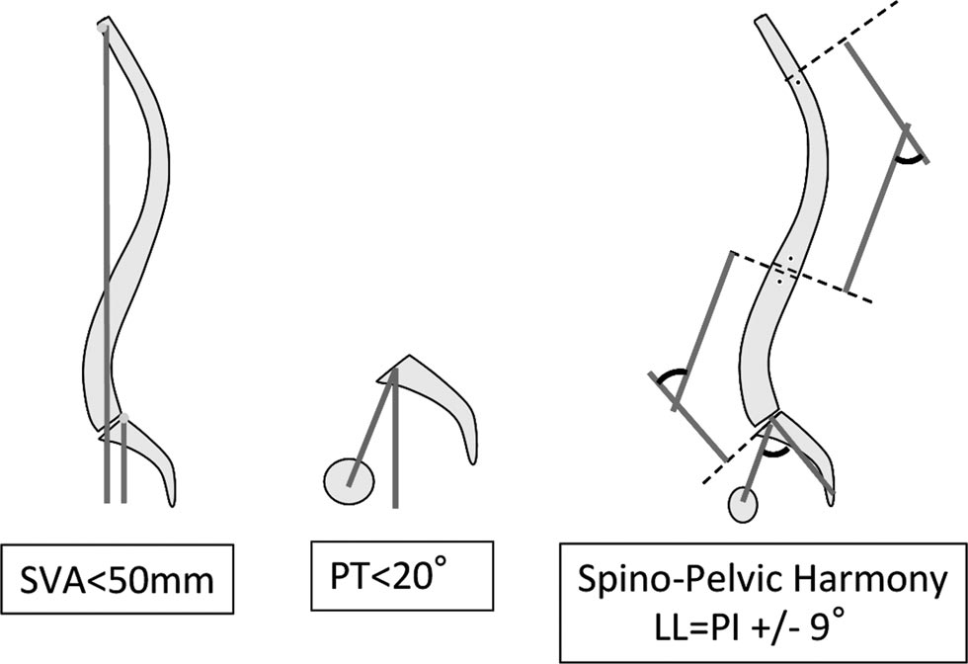
Goals
F. Schwab et al. Spine 35:25 2010

Slide 10
Goal
If Hyperkyphotic (TK >40)
LL<45 – TK –PI
Bridwell et al. Spine 34:8 2009

Slide 11
Type of Osteotomy
Posterior column: Smith Peterson /Ponte
  (mobile disc) – 5 to 15 deg.
  (Ankylosing sp) – 20 to 35 deg
3 column: PSO/ BDBO /– 25 to 40 degree
  Sagittal/Biplanes/Triplanes
VCR – 40 to 60 degree
Anterior/posterior :
  Disc (10 to 25 degree ; body (40 to 60 degree)

Slide 12
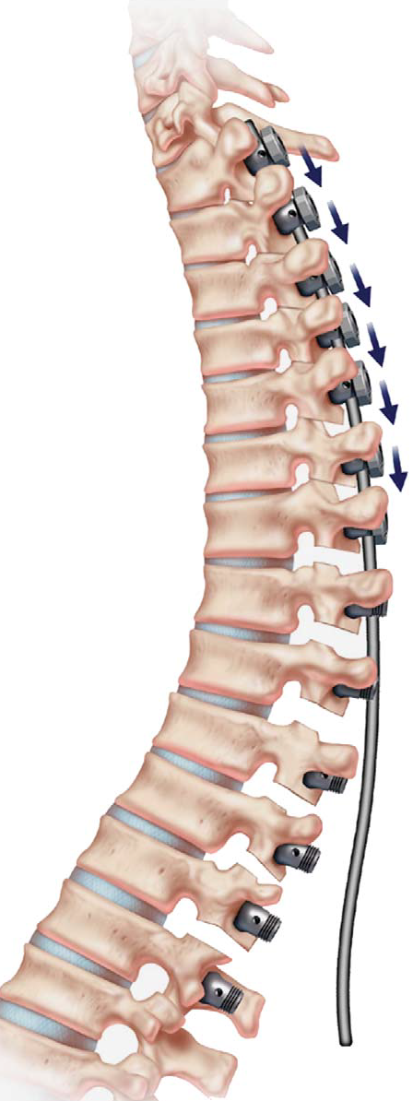
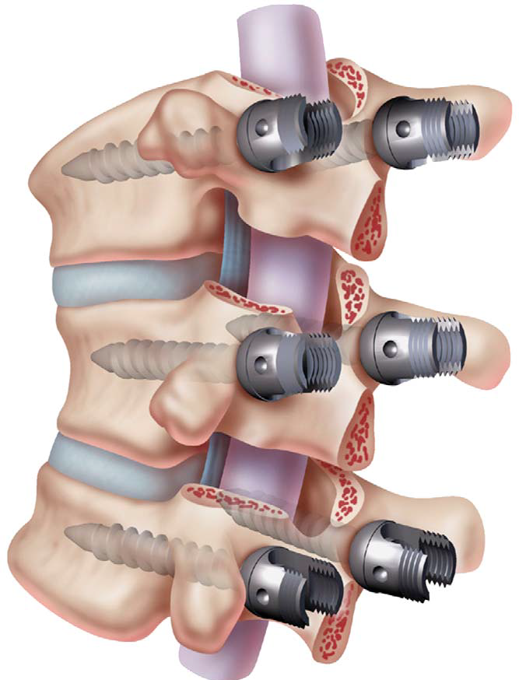
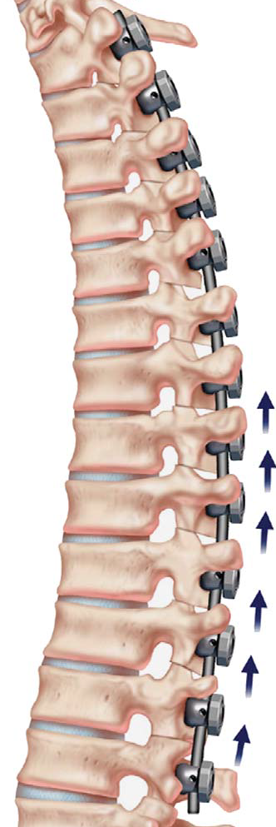
Ponte Osteotomy
(J Spinal Disord Tech 2007;20

Slide 13
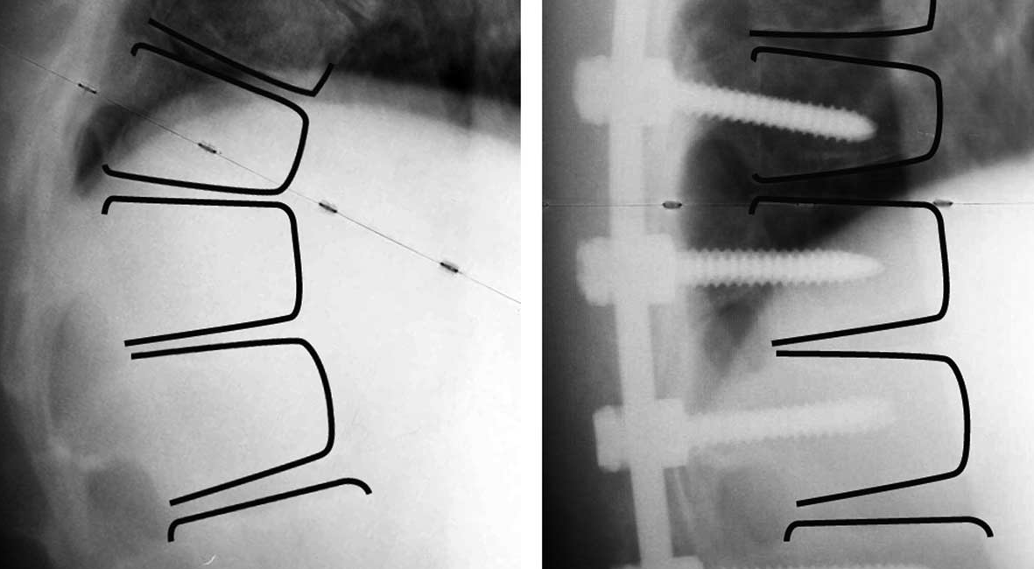
PONTE
Spine 2011 ; 36 : E1086 – E1092

Slide 14
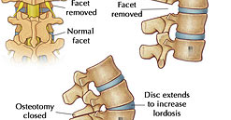
Smith Petersen Osteotomy - mobile disc

Slide 15
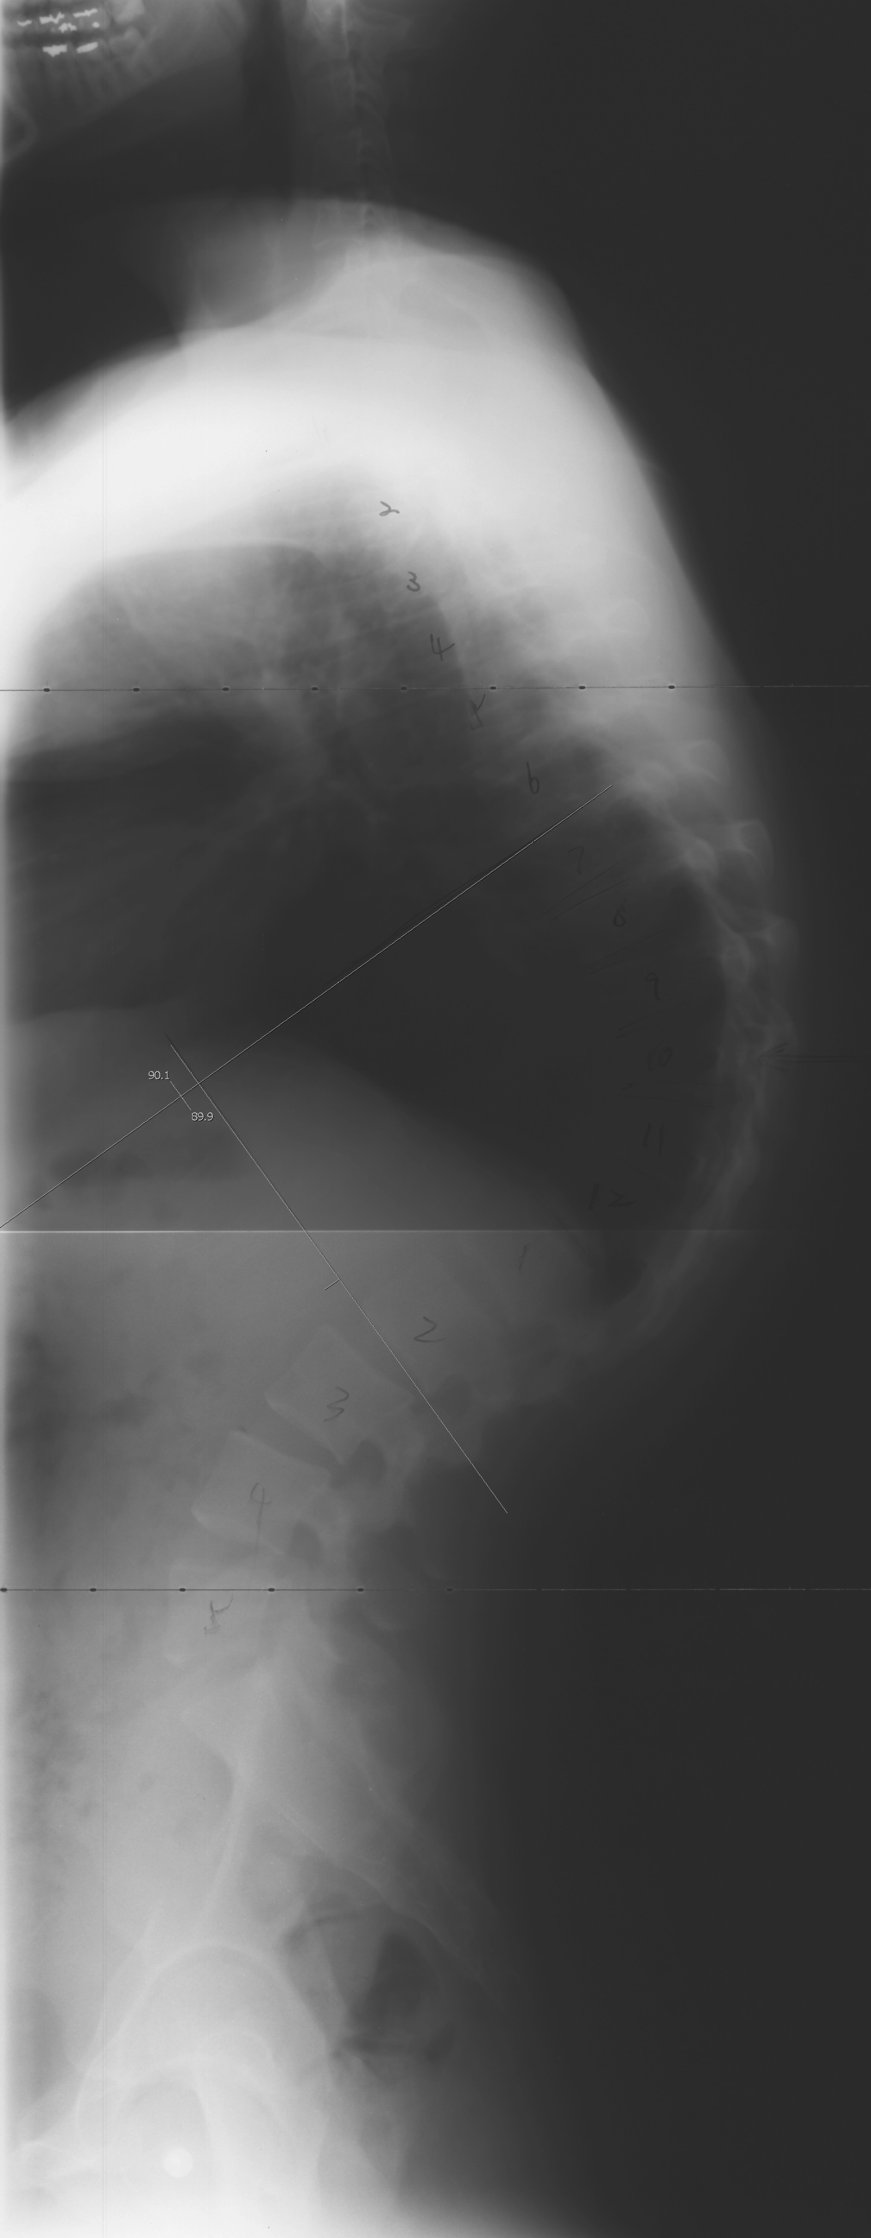
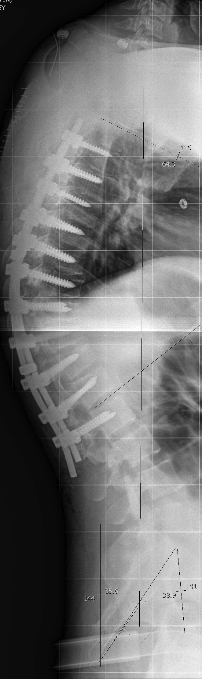
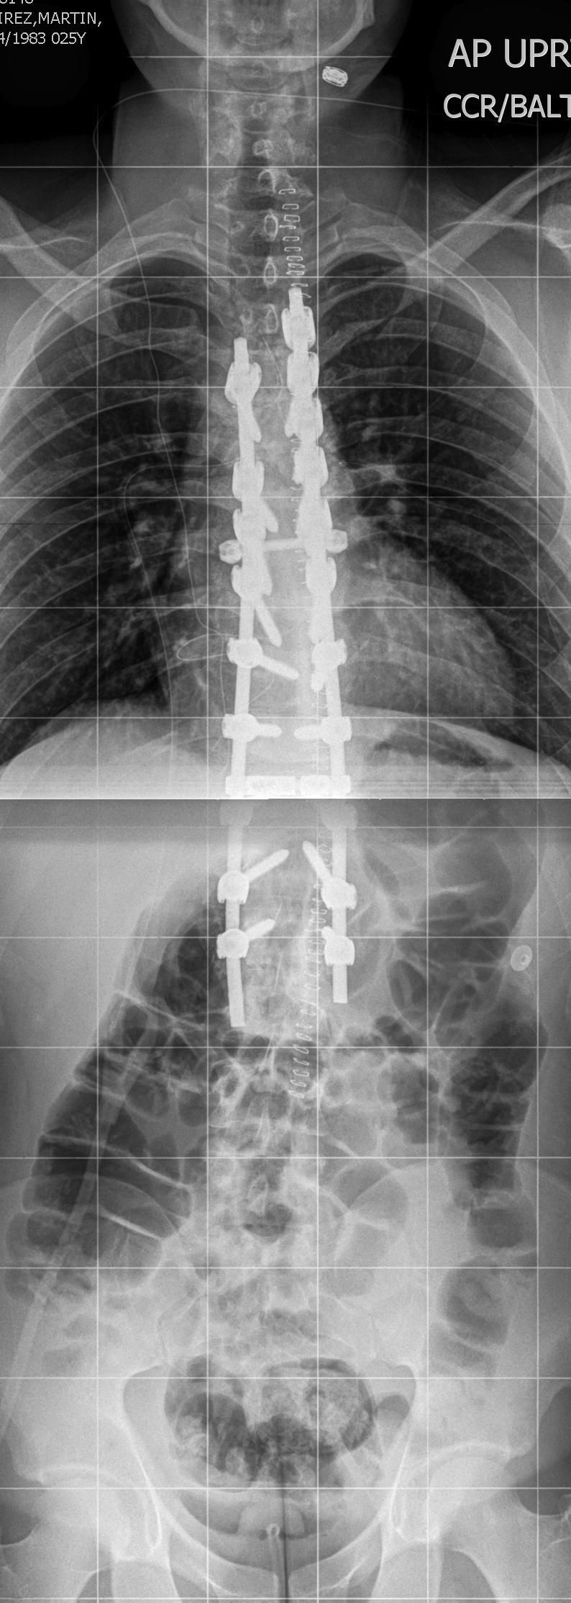
Smith Peterson Osteotomy

Slide 16
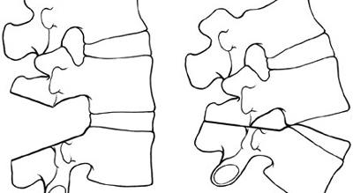
SPO: Ankylosing Spondylitis

Slide 17
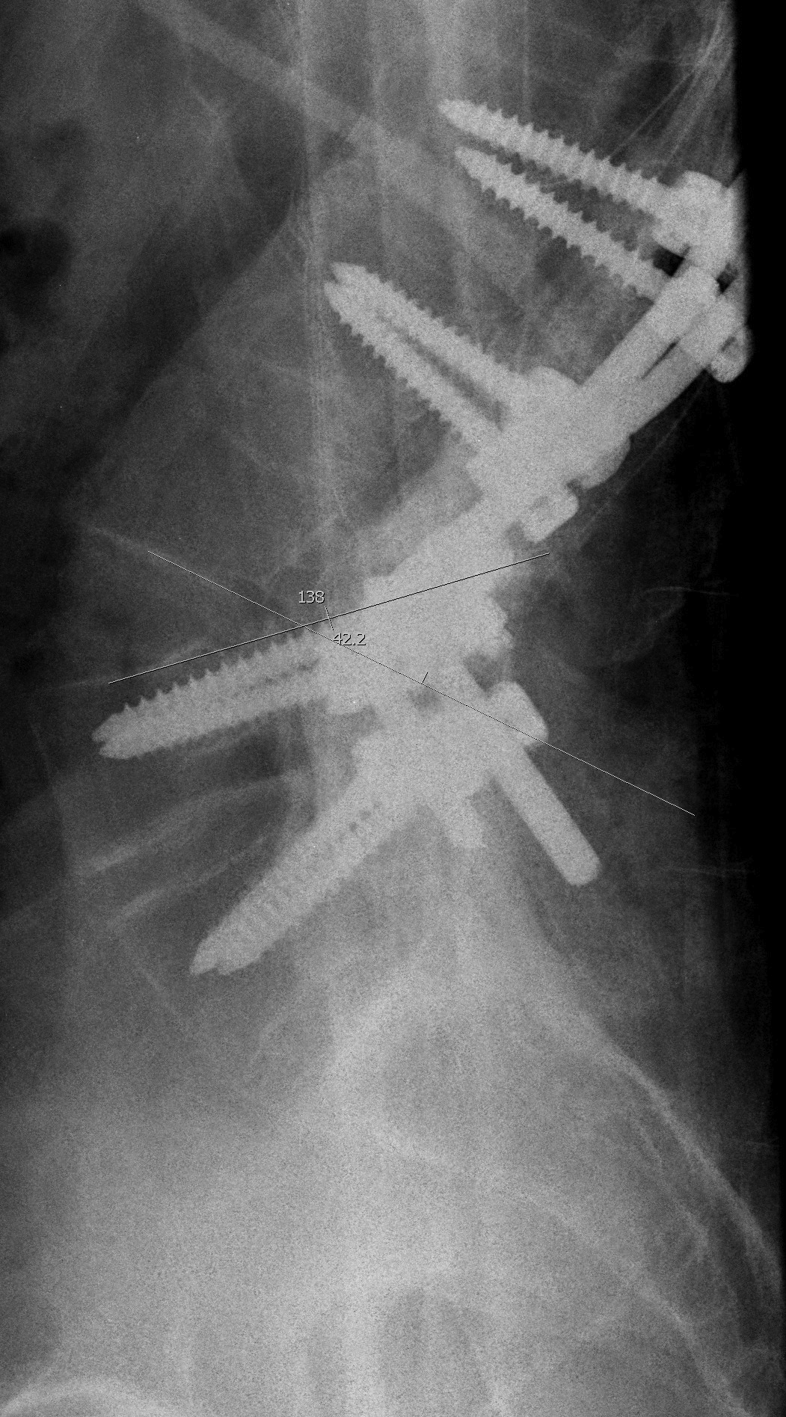
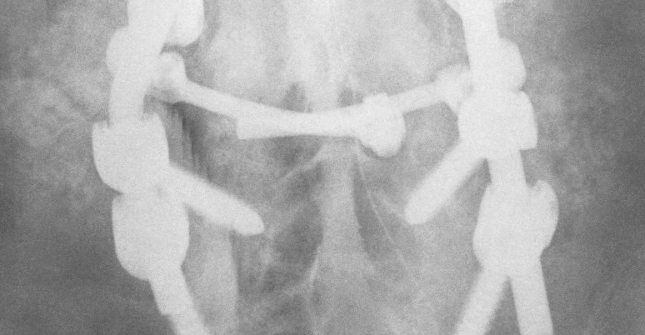
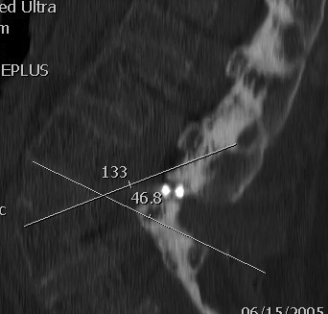
Smith Petersen Osteotomy

Slide 18
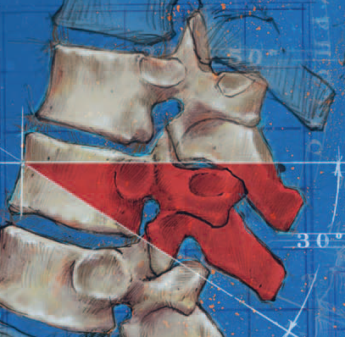
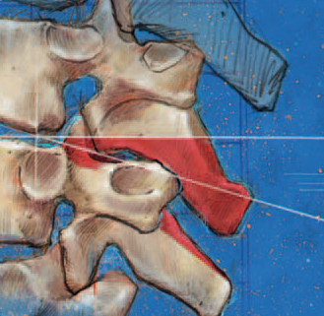
PSO VS SPO
PEDICLE SUBTRACTION
SMITH PETERSON

Slide 19
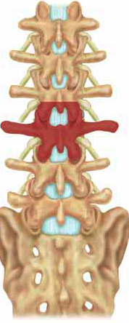
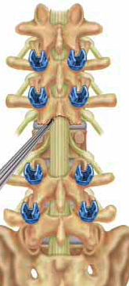
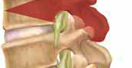
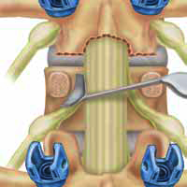
PSO - Bony resection

Slide 20
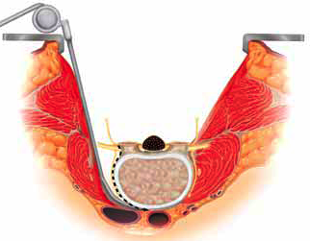
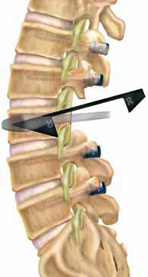
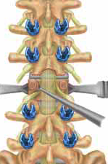
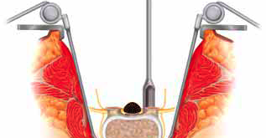
PSO

Slide 21
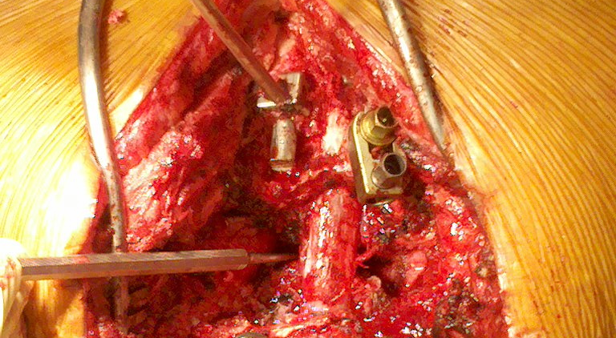
Osteotomy

Slide 22
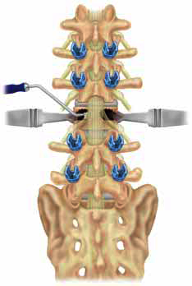
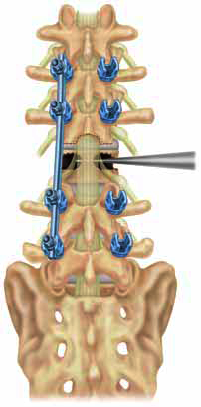
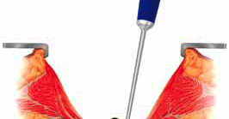
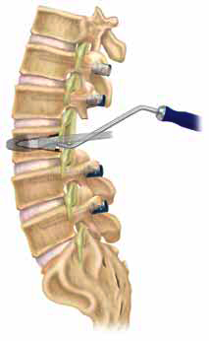
PSO

Slide 23
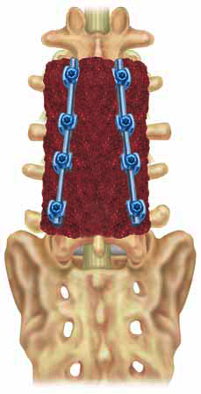
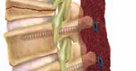
PSO

Slide 24
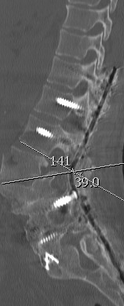
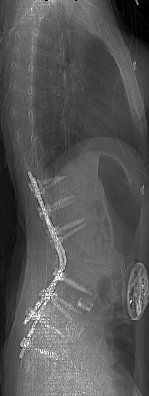
1 level pedicle subtraction osteotomy

Slide 25
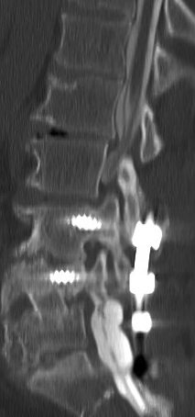
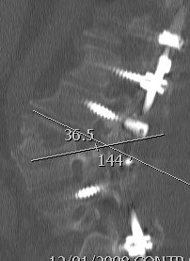
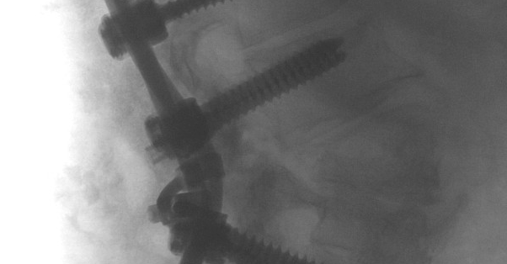
PSO

Slide 26
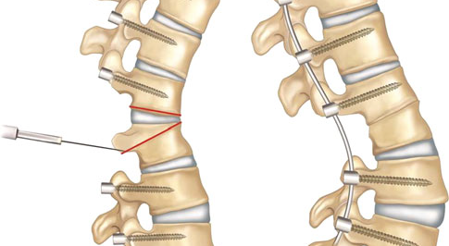
PSO variation
Bone Disc Bone Osteotomy

Slide 27
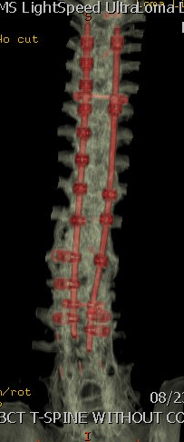
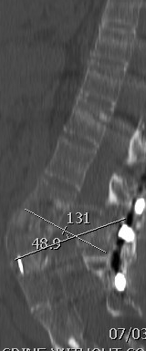
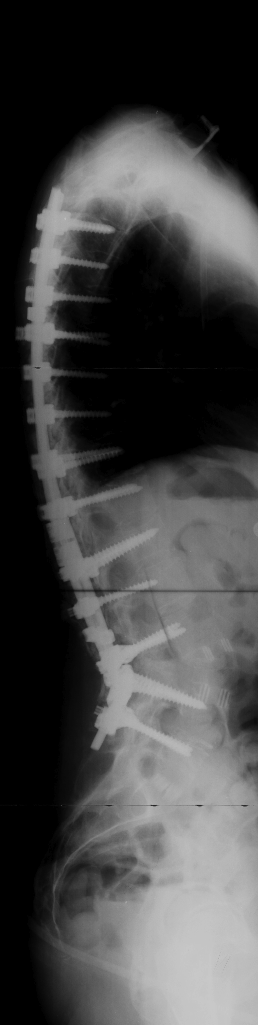

PSO
53 YO F, 16 prior back surgery

Slide 28


VCR

Slide 29


VCR

Slide 30

VCR

